Slide 1


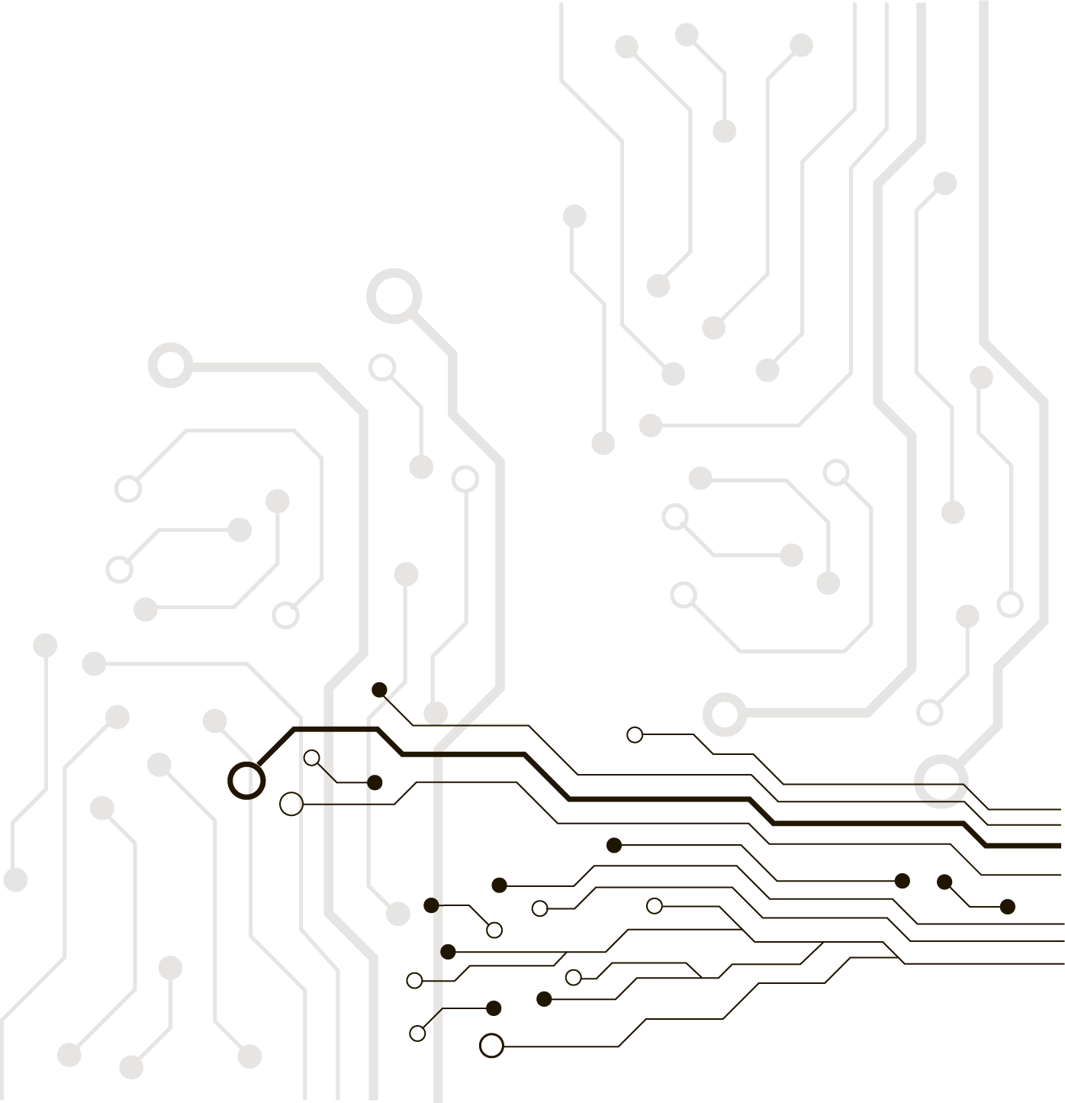
What is computer Programming?

Slide 2
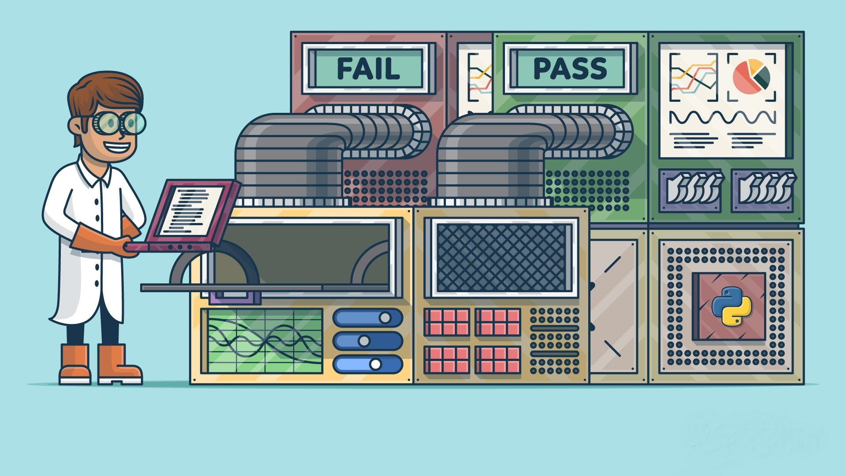
Computer Programming Definition
Computer programming is a way of giving computers instructions and tell them what to do next!

Slide 3


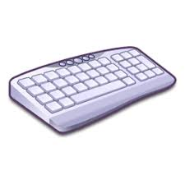
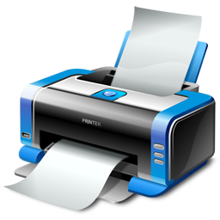
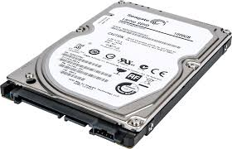


How Computers Work!
Computers main functions:
Program
Input
Process
Output
Storage

Slide 4
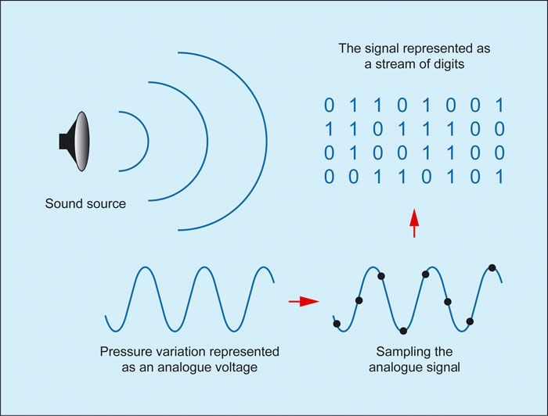
How Computers Work!
Computers are machines that perform mathematical operations on numbers using electronic voltage.
Example: Sound Processing:
Example: Image Processing:

Slide 5

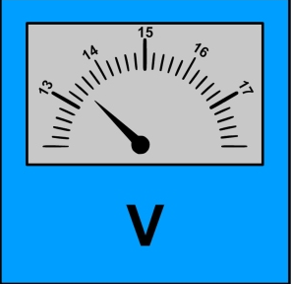
How Computers Work!
Let’s make a computer using electrical voltage to do mathematics:
Problem I: Scale
Problem II: Precision
+ =
+ =
+ =
2
3000
2.75
5
3003
5.95
3
3
3.2
Loss
2.00 V
3.00 V
3000.00 V
3.00 V
2.75 V
3.2 V

Slide 6

How Computers Work!
So What is the solution?
+ =
01101
Problems:
We need new system of counting using only 1 and 0
We need new algebra for doing math in this new system
100110
11001
Binary System
1 Volt
1 Volt
0 Volt
0 Volt

Slide 7
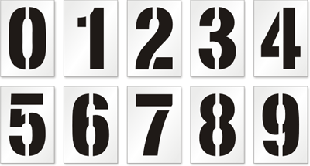

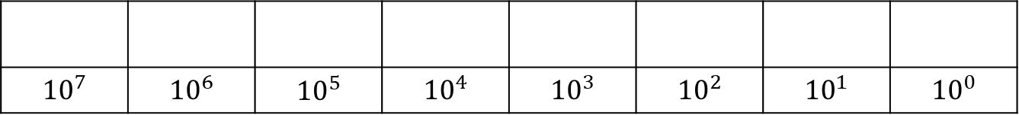

Decimal:
In Decimal System we have 10 symbols:
So decimal is a positional numeral system in which each position has positional notation of 10:
$${10}^{7}$$ | $${10}^{6}$$ | $${10}^{5}$$ | $${10}^{4}$$ | $${10}^{3}$$ | $${10}^{2}$$ | $${10}^{1}$$ | $${10}^{0}$$
 |  |  |  | 1 | 3 | 6 | 1
$${10}^{7}$$ | $${10}^{6}$$ | $${10}^{5}$$ | $${10}^{4}$$ | $${10}^{3}$$ | $${10}^{2}$$ | $${10}^{1}$$ | $${10}^{0}$$
1x ${10}^{3}$+3x${10}^{2}$+6x ${10}^{1}$+1x ${10}^{0}$
1$000$+300+60+1
1361

Slide 8
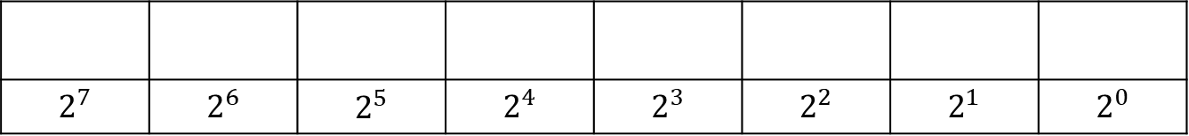
Binary:
In Binary System we have 2 symbols:
So Binary is a positional numeral system in which each position has positional notation of 2:
$$2^{7}$$ | $$2^{6}$$ | $$2^{5}$$ | $$2^{4}$$ | $$2^{3}$$ | $$2^{2}$$ | $$2^{1}$$ | $$2^{0}$$
1 | 1 | 0 | 1 | 1 | 0 | 1 | 1
$$2^{7}$$ | $$2^{6}$$ | $$2^{5}$$ | $$2^{4}$$ | $$2^{3}$$ | $$2^{2}$$ | $$2^{1}$$ | $$2^{0}$$
1x $2^{7}$+ 1x $2^{6}$+ 0x $2^{5}$+ 1x $2^{4}$+ 1x $2^{3}+\text{0}\text{x} 2^{2}$+ 1x $2^{1}+\text{1}\text{x} 2^{0}$
1x128+1x64+0x32+1x16+1x8+0x4+1x2+1x1
129

Slide 9
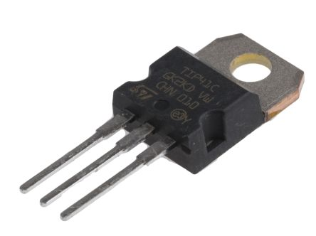

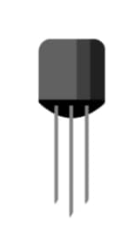
Lets complete our computer prototype:
Computers are machines that perform mathematical operations on numbers using electronic voltage.
To create this voltage with reasonable speed we use a electronic element called transistor
+ =
01101
100110
11001
Transistor can either be ON or OFF and can be switched On and off with very small voltage.
OFF
ON

Slide 10
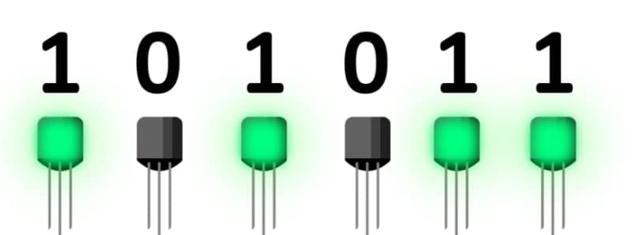
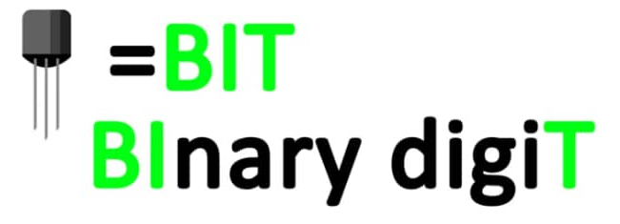
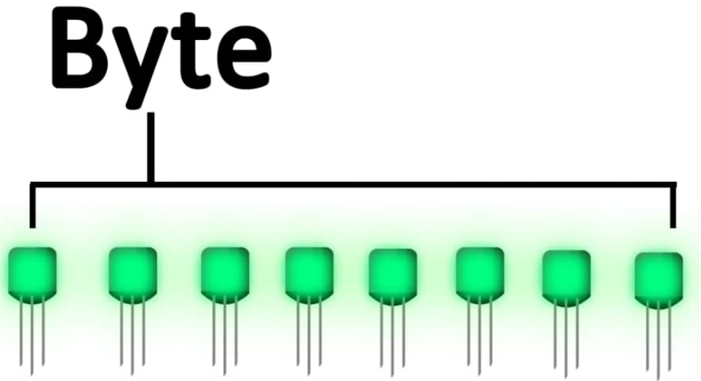
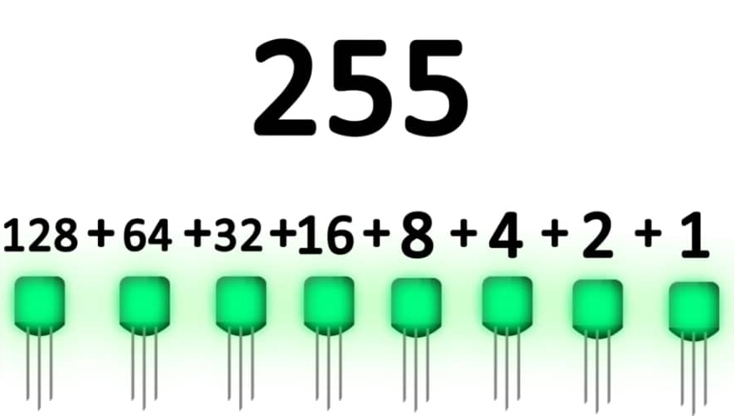
Transistors:

Slide 11
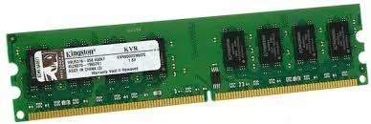
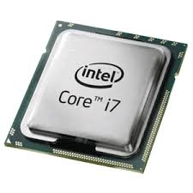
CPUs and Memories:
+ =
For adding two digits, using transistors, our computer should perform below functions:
01101
100110
Store Binary Value
11001
Perform Mathematic operation
RAM:
Random Access Memory
CPU:
Central processing Unit
3 billion Transistors
8 billion Transistor in 1G

Slide 12
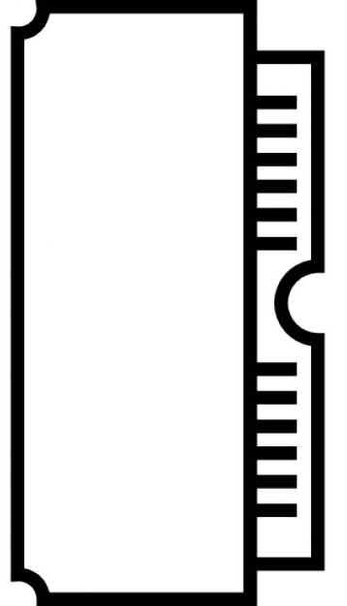
Random Access Memory:
Capacity: 16 Byte
16 Memory Location
Each Memory location=8 Bit
16x8=128 Bit=16 Byte
Instructions
Data
Control Bits

Slide 13

CPUs Function:
CPU
Instructions
Description | Control Bits
Get number in Memory Location 12 | 10011001
Get number in Memory Location 13 | 10001111
ADD Numbers in location 12 and 13 | 00011001
STORE in Memory Address 14 | 10001110
1:Fetch Instruction
2:Decode Instruction
3:Execution
DATA BUS
Data
Decode
Execute
Fetch
It is measured in clock cycles per second or its equivalent, hertz (Hz).
A CPU with a clock rate of 1 Hz executes 1 cycles per second.
Intel Core i7 clock rate is around 4 GHz, this means it executes 4 billion cycles per second
Execute
CPU Clock is used to synchronize the operations of CPU components. It is an indicator of the processor's speed.

Slide 14

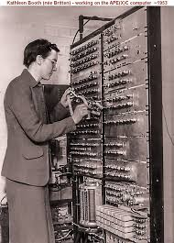
What is computer Programming?
Basically Programming is loading instruction and data to Ransom access Memory(RAM)
In early years of programming, programmers would use binary control Bits to program. They were using instruction table to find correct control bit.
Description | Control Bits
Get number in Memory Location 12 | 10011001
Get number in Memory Location 13 | 10001111
ADD Numbers in location 12 and 13 | 00011001
STORE in Memory Address 14 | 10001110
In 1947 “Kathleen Booth” Created Assembly language
Assembly Syntax (OPCODE) | Description | Control Bits
Load_A | Get number in Memory Location 12 | 10011001
Load_B | Get number in Memory Location 13 | 10001111
ADD | ADD Numbers in location 12 and 13 | 00011001
STORE | STORE in Memory Address 14 | 10001110

Slide 15


What is computer Programming?
“Kathleen Booth” Created a program to translate OPCODES to Control Bits
Assembler
OPCODE
01101101
Assembly is low level programming language. Each OPCODE is corresponding with one control Bit.

Slide 16
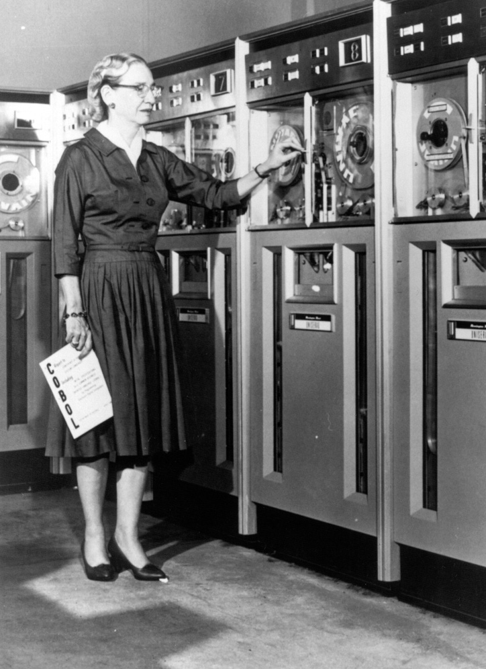

What is computer Programming?
In 1959 “Grace Hopper” invented first programming language called COBOL(COmmon Business-Oriented Language)
LOCAL-STORAGE SECTION.
01 LS-CLASS PIC 9(3)
Compiler
0101111000110110100100111001001001000100100100010011111110000001111000011110101001111111001111111111100000111111111
Hopper created a program which was translating Syntaxes to Binary Code.
Each COBOL syntax would execute several control Bits

Slide 17

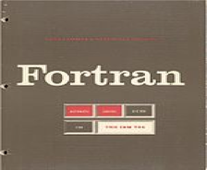


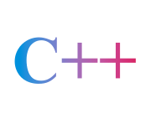







Programing Languages
Low Level Languages
High Level Languages
Machine Language
Assembly Language
1945
1972
1980
1991
1994
1991

Slide 18
Algorithm
Algorithm is a set of step-by-step instructions, placed in a right order to make something useful happen.
Brushing Your Teeth
Choosing what to wear!
Take lid off the toothpaste
If temperature is less than 10 degrees
Squeeze toothpaste on the brush
Wear Coat
Run Water onto the brush
If temperature is between 10 and 18
Brush teeth for 2 minutes
Wear Jumper
Spit and rinse the brush
If temperature is greater than 18
Wear T-shirt

Slide 19
Algorithm
Which Number is the largest?
4
17
23
12
25
24
25
6
20
19
9
13

Slide 20
Algorithm
Look at the first number on the screen. Remember it. Store it in your brain
Look at the next number
Question:
Is it larger than what you remembered?
YES!
NO!
Remember that one!
Forget that number and keep remembering the previous one.

Slide 21
What is computer Programming?
Computer programming is a process of designing and building executable instructions based on algorithms to accomplish a specific computing result or to perform a specific task.
Analyzing
Generating Algorithm
Translate Algorithm to Programming Language
Programming Process:

